Slide 5
INSERT SUMMARY OF DRAFT PLAN VIDEO FROM https://parracatholic.org/synod/resources/
Notes:
SUMMARY OF DRAFT PLAN VIDEO

Slide 8
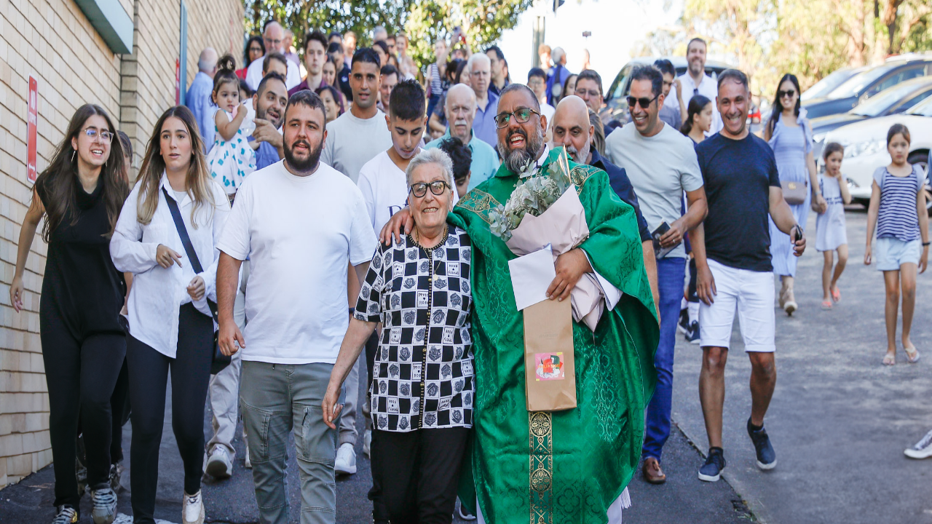
Think Tank Rounds

Slide 9
ROUND 1:
Having considered our local community’s context, which ONE resolution across the six themes from the Draft Plan do you personally believe most aligns with our community?

Slide 10
ROUND 1:
INSERT 10 MINUTE TIMER
Having considered our local community’s context, which ONE resolution across the six themes from the Draft Plan do you personally believe most aligns with our community?
Notes:
[Following 10 minutes of discussion, each person writes the resolution on one large sheet of butcher’s paper or A3 paper – one per group. All sheets of butcher’s paper to be stuck to a wall displayed as a gallery.
Participants spend 5 minutes reviewing the resolutions for consideration and discussion at their table group. Participants return to their table group.]

Slide 11
ROUND 2:
From what you’ve read and heard, which resolutions most align with our community’s needs?

Slide 12
INSERT 10 MINUTE TIMER
ROUND 2:
From what you’ve read and heard, which resolutions most align with our community’s needs?
Notes:
[Following 10 minutes of free discussion, each member of the group will write their initials next to THREE resolutions that they believe most resonates with their community and are committed to implementing.
The Facilitator will review the gallery and identify the TOP THREE resolutions with the most initials. These become the resolutions for discussion in Round 3.]

Slide 13
ROUND 3:
Having agreed on the priority resolutions, identify practical responses that our local community can implement.

Slide 14
ROUND 3:
INSERT 10 MINUTE TIMER
Having agreed on the priority resolutions, identify practical responses that our local community can implement.
[The Table Leader should be a scribe to collate into a Group Submission]
Notes:
Start timer once there is 10 minutes left in the 20 minute period. [During the 20 minutes of free discussion, the Table Leader should be a scribe to collate into a Group Submission.]

Slide 16
