Slide 2
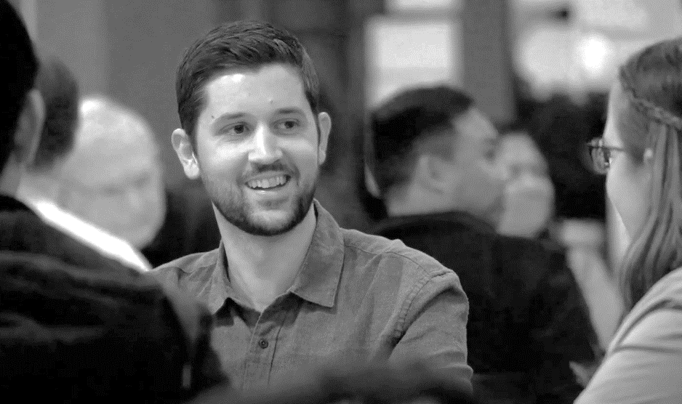
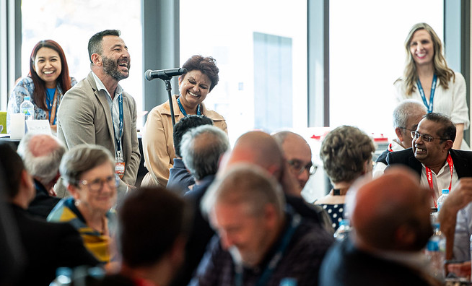
The Diocesan Plan for a Synodal Church
Drafting the Plan
After our first Diocesan Synod, we are developing a ‘way forward’ for our church in Western Sydney & the Blue Mountains – The Diocesan Plan for a Synodal Church
Leaders and ministry teams will provide recommendations for the Plan at ‘Think Tank sessions’ held between 29 April to 17 June
The Diocesan Plan for a Synodal Church will launch at a Diocesan Gathering on Saturday 10 August 2024
Think Tank Sessions
Diocesan Gathering
10 AUGUST 2024
Notes:
SINGLE SLIDE – General Info

