Slide 1





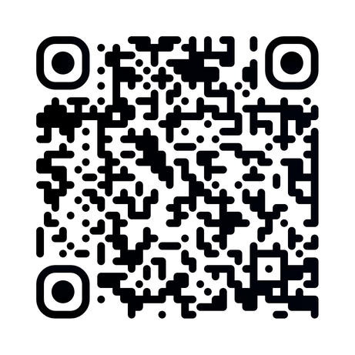
AGES: 18-35
EXPERIENCE WORLD YOUTH DAY WITH US
APPLICATIONS ARE NOW OPEN!

